Slide 1
5G-QOE Modelling for UHD Video Streaming in 5G Networks
5G-QoE Modelling for UHD Video Streaming in 5G Networks
ANAND CHANDAR P B
Roll no: 10 S7 B.Tech CSE
15/11/2018
Dept. of CSE, MACE Kothamangalam
1
Notes:
mace
<Adaptive Feature Mapping for facial expression recognition>
<footer>
1
3/24/2019
3/24/2019

Slide 2
5G-QOE Modelling for UHD Video Streaming in 5G Networks
OBJECTIVE
Proposes 5G-QoE framework
Developed and implemented as part of EU 5G PPP SELFNET.
EU 5G PPP SELFNET project has proposed a QoE-aware Self-Optimisation Use Case.
The key enabler in this use case is a QoE prediction model.
15/11/2018
Dept. of CSE, MACE Kothamangalam
2

Slide 3
5G-QOE Modelling for UHD Video Streaming in 5G Networks
CHALLENGES
Reliable
Accurate
Scalable
Robust
Current QoE models do not focus on 5G networks.
Current QoE model only consider single layer video type.
15/11/2018
Dept. of CSE, MACE Kothamangalam
3
Notes:
3
<footer>
<Adaptive Feature Mapping for Customizing Deep Learning Based Facial Expression Recognition Model>
3/24/2019

Slide 4
5G-QOE Modelling for UHD Video Streaming in 5G Networks
RELATED WORKS
QoE modelling approaches
- Subjective QoE Model
- Objective QoE Models
15/11/2018
Dept. of CSE, MACE Kothamangalam
4
Notes:
4
<footer>
<Adaptive Feature Mapping for Customizing Deep Learning Based Facial Expression Recognition Model>
3/24/2019

Slide 5
5G-QOE Modelling for UHD Video Streaming in 5G Networks
SUBJECTIVE QoE MODEL
Organized sessions of end users who view video content.
Rate the visual quality using a MOS metric.
Subjective test involves direct data collection from users.
15/11/2018
Dept. of CSE, MACE Kothamangalam
5
Notes:
5
<footer>
<Adaptive Feature Mapping for Customizing Deep Learning Based Facial Expression Recognition Model>
3/24/2019

Slide 6
5G-QOE Modelling for UHD Video Streaming in 5G Networks
DISADVANTAGES
Time-consuming
Labour-intensive
Expensive
15/11/2018
Dept. of CSE, MACE Kothamangalam
6
Notes:
6
<footer>
<Adaptive Feature Mapping for Customizing Deep Learning Based Facial Expression Recognition Model>
3/24/2019

Slide 7
5G-QOE Modelling for UHD Video Streaming in 5G Networks
OBJECTIVE QoE MODELS
Collected measurements of factors that affect QoE.
Directly map an objective measurement of video quality.
15/11/2018
Dept. of CSE, MACE Kothamangalam
7
Notes:
7
<footer>
<Adaptive Feature Mapping for Customizing Deep Learning Based Facial Expression Recognition Model>
3/24/2019

Slide 8
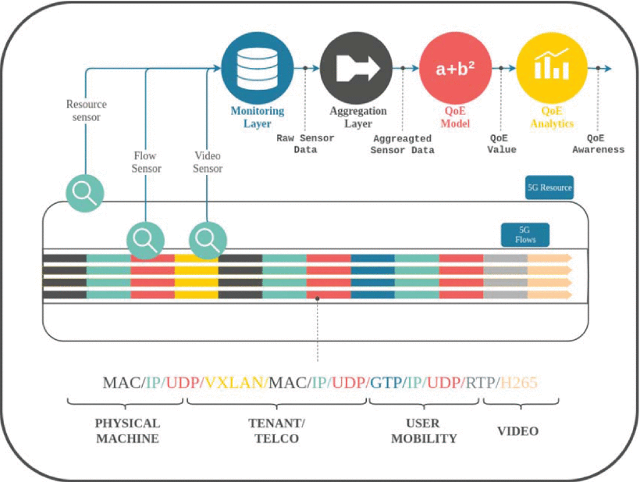
5G-QOE Modelling for UHD Video Streaming in 5G Networks
PROPOSED 5G-QoE SYSTEM OVERVIEW
Courtesy : https://ieeexplore.ieee.org/document/8332093/
15/11/2018
Dept. of CSE, MACE Kothamangalam
8
Notes:
8
<footer>
<Adaptive Feature Mapping for Customizing Deep Learning Based Facial Expression Recognition Model>
3/24/2019

Slide 9
5G-QOE Modelling for UHD Video Streaming in 5G Networks
MONITORING LAYER
Inspect and extract metrics from physical and virtual.
And the data flows traversing the network.
Monitoring data are stored in a database.
Three sensors,
Flow sensor
Video sensor
Resource sensor
15/11/2018
Dept. of CSE, MACE Kothamangalam
9
Notes:
9
<footer>
<Adaptive Feature Mapping for Customizing Deep Learning Based Facial Expression Recognition Model>
3/24/2019

Slide 10
5G-QOE Modelling for UHD Video Streaming in 5G Networks
FLOW SENSOR
Flow sensor inspects every flow passing through
The network, acquiring information and metrics.
Flow state
Source, Destination
Bandwidth consumed at each level of encapsulation.
15/11/2018
Dept. of CSE, MACE Kothamangalam
10
Notes:
10
<footer>
<Adaptive Feature Mapping for Customizing Deep Learning Based Facial Expression Recognition Model>
3/24/2019

Slide 11
5G-QOE Modelling for UHD Video Streaming in 5G Networks
VIDEO SENSOR
Bitrate
Spatial resolution
Scene change information
15/11/2018
Dept. of CSE, MACE Kothamangalam
11
Notes:
11
<footer>
<Adaptive Feature Mapping for Customizing Deep Learning Based Facial Expression Recognition Model>
3/24/2019

Slide 12
5G-QOE Modelling for UHD Video Streaming in 5G Networks
RESOURCE SENSOR
Monitors and acquires metrics.
Information about available bandwidth
Identity of data flows passing through all network interfaces.
15/11/2018
Dept. of CSE, MACE Kothamangalam
12
Notes:
12
<footer>
<Adaptive Feature Mapping for Customizing Deep Learning Based Facial Expression Recognition Model>
3/24/2019

Slide 13
5G-QOE Modelling for UHD Video Streaming in 5G Networks
DATA AGGREGATOR
Congestion Index (CI)
Measures the maximum level of congestion.
15/11/2018
Dept. of CSE, MACE Kothamangalam
13
Notes:
13
<footer>
<Adaptive Feature Mapping for Customizing Deep Learning Based Facial Expression Recognition Model>
3/24/2019

Slide 14
5G-QOE Modelling for UHD Video Streaming in 5G Networks
QoE MODELING
From the flow sensor to determine the current state of each layer
From the video sensor the required bitrate, spatial resolution.
Available bandwidth information from the resource sensor
15/11/2018
Dept. of CSE, MACE Kothamangalam
14
Notes:
14
<footer>
<Adaptive Feature Mapping for Customizing Deep Learning Based Facial Expression Recognition Model>
3/24/2019

Slide 15
5G-QOE Modelling for UHD Video Streaming in 5G Networks
QoE ANALYSIS
Provide appropriate QoE alerts
Trigger interventions to drop layers from a video stream.
15/11/2018
Dept. of CSE, MACE Kothamangalam
15
Notes:
15
<footer>
<Adaptive Feature Mapping for Customizing Deep Learning Based Facial Expression Recognition Model>
3/24/2019

Slide 16
5G-QOE Modelling for UHD Video Streaming in 5G Networks
METHODOLOGY
A set of 4k resolution video clips were obtained
The video clips then used in an extensive series of subjective test
The videos were split into two sets, a training set and validation set
Subjects viewed and compared both videos
15/11/2018
Dept. of CSE, MACE Kothamangalam
16
Notes:
16
<footer>
<Adaptive Feature Mapping for Customizing Deep Learning Based Facial Expression Recognition Model>
3/24/2019

Slide 17
5G-QOE Modelling for UHD Video Streaming in 5G Networks
METHODOLOGY (Contd...)
Results of the first set of subjective evaluations (training set).
Used in a statistical modelling approach.
To derive a candidate QoE prediction formula.
This formula analytically validated against the subjective scores
Then subsequently implemented and empirically evaluated
15/11/2018
Dept. of CSE, MACE Kothamangalam
17
Notes:
17
<footer>
<Adaptive Feature Mapping for Customizing Deep Learning Based Facial Expression Recognition Model>
3/24/2019

Slide 18
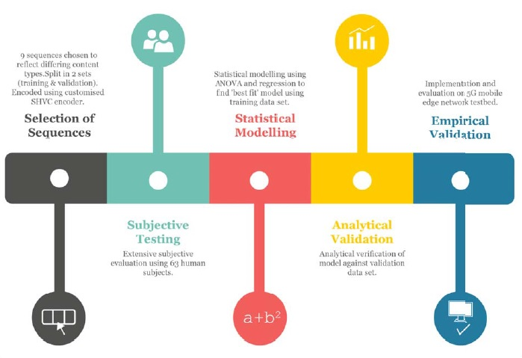
DIAGRAMMATIC REPRESENTATION OF METHODOLOGY AND WORKFLOW
5G-QOE Modelling for UHD Video Streaming in 5G Networks
Courtesy : https://ieeexplore.ieee.org/document/8332093/
15/11/2018
Dept. of CSE, MACE Kothamangalam
18
Notes:
18
<footer>
<Adaptive Feature Mapping for Customizing Deep Learning Based Facial Expression Recognition Model>
3/24/2019

Slide 19
5G-QOE Modelling for UHD Video Streaming in 5G Networks
SEQUENCE SELECTION
Nine short video sequences were encoded
2 scalable layers,
Base layer
Enhancement layer
15/11/2018
Dept. of CSE, MACE Kothamangalam
19
Notes:
19
<footer>
<Adaptive Feature Mapping for Customizing Deep Learning Based Facial Expression Recognition Model>
3/24/2019

Slide 20
5G-QOE Modelling for UHD Video Streaming in 5G Networks
SEQUENCE SELECTION (Cond..)
Base layer had a spatial resolution of 1920x1080 Full HD.
Enhancement layer with a spatial resolution of 3840x2160.
The clips were organised into two sets:
First set consisted of 4 clips, all with a frame rate of 30fps
Second set of 5 sequences each with a frame rate of 24fps
15/11/2018
Dept. of CSE, MACE Kothamangalam
20
Notes:
20
<footer>
<Adaptive Feature Mapping for Customizing Deep Learning Based Facial Expression Recognition Model>
3/24/2019

Slide 21
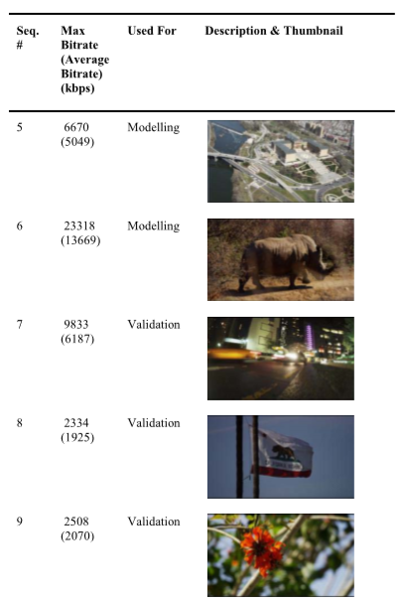
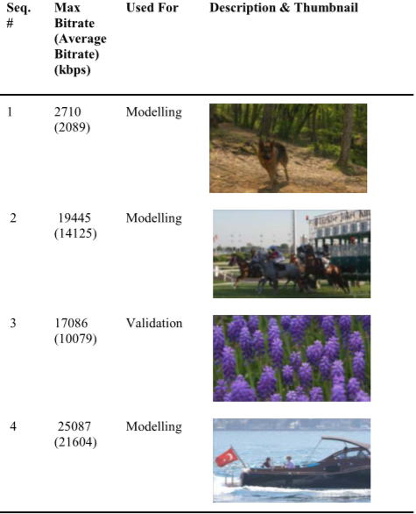
5G-QOE Modelling for UHD Video Streaming in 5G Networks
SEQUENCE SELECTION (Cond..)
30FPS
24FPS
Courtesy : https://ieeexplore.ieee.org/document/8332093/
15/11/2018
Dept. of CSE, MACE Kothamangalam
21
Notes:
21
<footer>
<Adaptive Feature Mapping for Customizing Deep Learning Based Facial Expression Recognition Model>
3/24/2019

Slide 22
5G-QOE Modelling for UHD Video Streaming in 5G Networks
SUBJECTIVE TESTING PLATFORM
Video sample compared with the reference sample same video clip.
Three nodes
Server node
Intermediate routing node
Client node
15/11/2018
Dept. of CSE, MACE Kothamangalam
22
Notes:
22
<footer>
<Adaptive Feature Mapping for Customizing Deep Learning Based Facial Expression Recognition Model>
3/24/2019

Slide 23
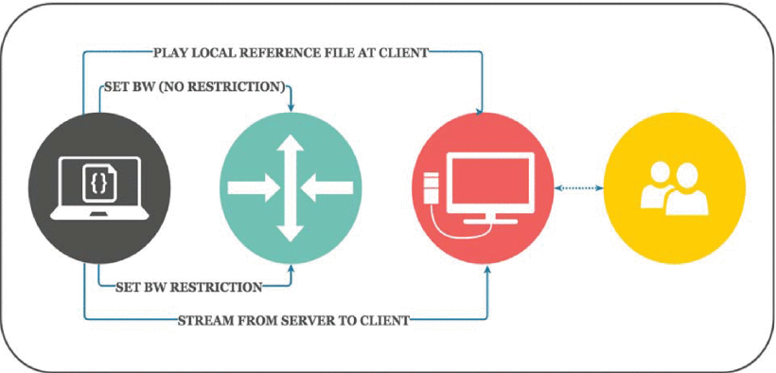
5G-QOE Modelling for UHD Video Streaming in 5G Networks
SUBJECTIVE TESTING PLATFORM (Cond..)
Courtesy : https://ieeexplore.ieee.org/document/8332093/
15/11/2018
Dept. of CSE, MACE Kothamangalam
23
Notes:
23
<footer>
<Adaptive Feature Mapping for Customizing Deep Learning Based Facial Expression Recognition Model>
3/24/2019

Slide 24
5G-QOE Modelling for UHD Video Streaming in 5G Networks
SUBJECTIVE EVALUATION
Subjects view the series of video clips, each of 10 seconds duration
The clips were presented in pairs
First the reference video played locally at the client
15/11/2018
Dept. of CSE, MACE Kothamangalam
24
Notes:
24
<footer>
<Adaptive Feature Mapping for Customizing Deep Learning Based Facial Expression Recognition Model>
3/24/2019

Slide 25
5G-QOE Modelling for UHD Video Streaming in 5G Networks
SUBJECTIVE EVALUATION (Cond..)
After a 5 seconds views another copy of the same video streamed
Subjects record their subjective opinion using the (ACR) scale.
15/11/2018
Dept. of CSE, MACE Kothamangalam
25
Notes:
25
<footer>
<Adaptive Feature Mapping for Customizing Deep Learning Based Facial Expression Recognition Model>
3/24/2019

Slide 26
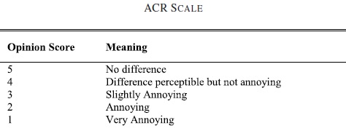
5G-QOE Modelling for UHD Video Streaming in 5G Networks
ABSOLUTE CATEGORY RATING(ACR) SCALE
Courtesy : https://ieeexplore.ieee.org/document/8332093/
15/11/2018
Dept. of CSE, MACE Kothamangalam
26
Notes:
26
<footer>
<Adaptive Feature Mapping for Customizing Deep Learning Based Facial Expression Recognition Model>
3/24/2019

Slide 27
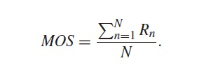
5G-QOE Modelling for UHD Video Streaming in 5G Networks
MEAN OPINION SCORE (MOS)
Arithmetic mean of the scores provided by individual human subjects.
R is the rating provided by an individual user
N is the number of users
15/11/2018
Dept. of CSE, MACE Kothamangalam
27
Notes:
27
<footer>
<Adaptive Feature Mapping for Customizing Deep Learning Based Facial Expression Recognition Model>
3/24/2019

Slide 28

5G-QOE Modelling for UHD Video Streaming in 5G Networks
CONGESTION INDEX (CI)
M-Maximum required bandwidth
A-Available Bandwidth
15/11/2018
Dept. of CSE, MACE Kothamangalam
28
Notes:
28
<footer>
<Adaptive Feature Mapping for Customizing Deep Learning Based Facial Expression Recognition Model>
3/24/2019

Slide 29

5G-QOE Modelling for UHD Video Streaming in 5G Networks
QUALITY INDEX (Q)
M-Maximum required bandwidth
A-Available Bandwidth
15/11/2018
Dept. of CSE, MACE Kothamangalam
29
Notes:
29
<footer>
<Adaptive Feature Mapping for Customizing Deep Learning Based Facial Expression Recognition Model>
3/24/2019

Slide 30
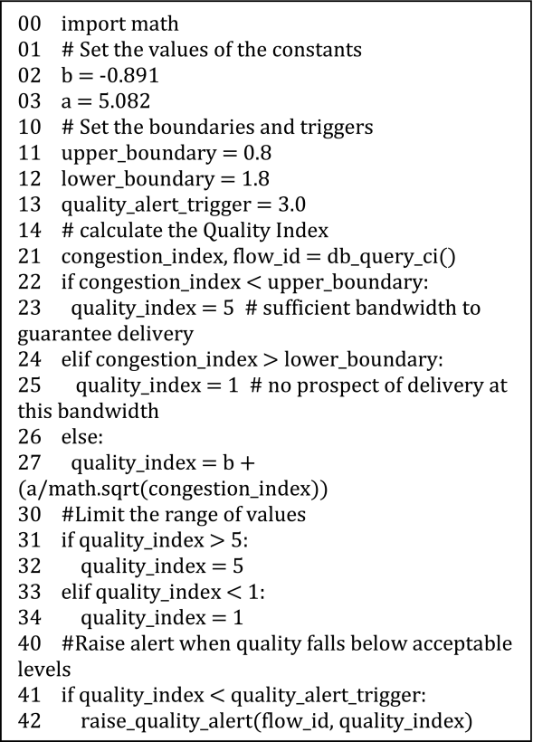
PSEUDO-CODE FOR QOE PREDICTION AND ALERT
5G-QOE Modelling for UHD Video Streaming in 5G Networks
Courtesy : https://ieeexplore.ieee.org/document/8332093/
15/11/2018
Dept. of CSE, MACE Kothamangalam
30
Notes:
30
<footer>
<Adaptive Feature Mapping for Customizing Deep Learning Based Facial Expression Recognition Model>
3/24/2019

Slide 31
5G-QOE Modelling for UHD Video Streaming in 5G Networks
CONCLUSION
A fast and scalable method of estimating quality of experience of users.
To achieved multi-tenancy and mobility.
Providing empirical QoE scores that closely match both those predicted by the model.
Future work will concentrate on building a QoE video adaptation system.
15/11/2018
Dept. of CSE, MACE Kothamangalam
31
Notes:
The model has been analytically and empirically evaluated against the results of subjective testing with results showing an accuracy of up to 94%.
31
<footer>
<Adaptive Feature Mapping for Customizing Deep Learning Based Facial Expression Recognition Model>
3/24/2019

Slide 32
REFERENCES
5G-QOE Modelling for UHD Video Streaming in 5G Networks
[1] “Cisco visual networking index (VNI) global mobile data trafﬁc forecast update,” San Jose, CA, USA, Cisco, White Paper, 2016. [Online]. Available: http://www.cisco.com/c/en/us/solutions/collateral/serviceprovider/visualnetworking-index-vni/mobile-white-paper-c11520862.html.USA
[2] 5G PPP. (2013). Advanced 5G Network Infrastructure for the Future Internet. [Online]. Available: https://5g-ppp.eu/wpcontent/uploads/2014/02/Advanced-5GNetwork-Infrastructure-PPPin-H2020_Final_November-2013.pdf
[3] 5G PPP. (2015). 5G Vision—The 5G Infrastructure Public Private Partnership: The Next Generation of Communication Networks and Services. [Online]. Available: https://5g-ppp.eu/ wp-content/uploads/2015/02/5G-Vision-Brochure-v1.pdf
[4] J. Ohm, G. J. Sullivan, H. Schwarz, T. K. Tan, and T. Wiegand, “Comparison of the coding efﬁciency of video coding standardsincluding high efﬁciency video coding (HEVC),” IEEE Trans. Circuits Syst. Video Technol., vol. 22, no. 12, pp. 1669–1684, Dec. 2012, doi: 10.1109/TCSVT.2012.2221192.
[5] “High efﬁciency video coding,” Int. Telecommun. Union, Geneva, Switzerland, ITU-T Recommendation H.265 (V4), Dec. 2016. [Online]. Available: http://www.itu.int/ITU-T/recommendations/rec.aspx?rec= 11885
[6] (2017). DisplayPort. [Online]. Available: http://www.displayport.org/ wp-content/uploads/2016/06/Display-Summit-USA-2016-AMD-VESASAH_Final_r1.pdf
15/11/2018
Dept. of CSE, MACE Kothamangalam
32
Notes:
32
<footer>
<Adaptive Feature Mapping for Customizing Deep Learning Based Facial Expression Recognition Model>
3/24/2019

Slide 33
REFERENCES
5G-QOE Modelling for UHD Video Streaming in 5G Networks
[7] (2017). Japan Display. [Online]. Available: http:// www.j-display.com/english/news/2017/20170519.html
[8] 5G PPP. (2017). 5G-PPP Key Performance Indicators (KPIs). [Online]. Available: https://5g-ppp.eu/kpis/.DaunmuDaunmu
[9] The EU 5G PPP SELFNET Project. (Apr. 2017). SELFNET: A Framework for Self-Organized Network Management in Virtualized and Software Deﬁned Networks. [Online]. Available: https://selfnet-5g.eu/
[10] P. Neves et al., “Future mode of operations for 5G—The SELFNET approach enabled by SDN/NFV,” Comput. Stand. Interfaces, vol. 54, pp. 229–246, Nov. 2017, doi: 10.1016/j.csi.2016.12.008
[11] A. Takahashi, D. Hands, and V. Barriac, “Standardization activities in
the ITU for a QoE assessment of IPTV,” IEEE Commun. Mag., vol. 46,
no. 2, pp. 78–84, Feb. 2008, doi: 10.1109/MCOM.2008.4473087.
[12] I. Slivar, M. Suznjevic, and L. Skorin-Kapov, “The impact of video
encoding parameters and game type on QoE for cloud gaming: A case
study using the steam platform,” in Proc. 7th Int. Workshop Qual.
Multimedia Experience (QoMEX), Pylos-Nestor, Greece, 2015, pp. 1–6.
15/11/2018
Dept. of CSE, MACE Kothamangalam
33
Notes:
33
<footer>
<Adaptive Feature Mapping for Customizing Deep Learning Based Facial Expression Recognition Model>
3/24/2019

Slide 34
5G-QOE Modelling for UHD Video Streaming in 5G Networks
THANK YOU
15/11/2018
Dept. of CSE, MACE Kothamangalam
34

